Slide 1
Exiting Spring 2016 NIFS Internship Presentation
Jessica Hathaway
Notes:
Good Morning, My Name is Jessica Hathaway. I am a student at Elizabeth City State University, in Elizabeth City, NC. I am a Mathematics Education Major. During this presentation I will be going over my experience that I had here this spring working in the Office of Education with DLN and NIFS.
**BREATHE***

Slide 2
Abstract Overview
Learned content of two of the most popular DLN™ modules
Our Magnificent Sun
Our Planet Earth
Researched different studio equipment
Keywords: tricaster, science, technology, engineering, mathematics, STEM, sun, Earth, NASA, Digital Learning Network™ (DLN)

Slide 3
Organizing the Studio Closet
Researched studio equipment
Learned about different technology
Notes:
Organization of Cables
HDMI
Video
Audio
VGA
XLR
AES/EBU
Organizations of tools
Labeling

Slide 4
Tandem Teaching and Lurking of the Top Ten Modules
Our Planet Earth
Our Magnificent Sun
Notes:
The main modules that I focused on were Our Planet Earth and Our Magnificent Sun.
Our Planet Earth is designed for kindergarten to sixth grade students.
Students learned about the Earth with all its varied environments, how its systems interact, and how we gather and use information about the Earth from NASA satellites.
Our Magnificent Sun is designed for kindergarten through second grade audiences.
Students learned about the features of the Sun including, sunspots, solar flares, and solar winds.
In preparations to presenting these modules, I viewed the other centers subject matter experts do not only these modules but the other top ten as well.

Slide 5
DLN™ Module Chart
DLN™ Modules
Name of Module | Host | Date | Assisted?
Our Planet Earth | Caryn Smith-Long | 1/27/2016 | no
Our Planet Earth | Caryn Smith-Long | 2/9/2016 | no
Our Planet Earth | Caryn Smith-Long | 2/24/2016 | yes
Our Solar Neighborhood | Roger Storm | 3/7/2016 | no
Our Magnificent Sun | Caryn Smith-Long | 3/8/2016 | no
Our Planet Earth | Rachel Power | 3/9/2016 | no
Our Planet Earth (am) | Caryn Smith-Long | 3/14/2016 | yes
Our Planet Earth (pm) | Caryn Smith-Long | 3/14/2016 | yes
States of Matter | Caryn Smith-Long | 3/15/2016 | no
Human in Space | Caryn Smith-Long | 3/16/2016 | no
Solar Neighborhood | Micheal Hare | 3/18/2016 | no
States of Matter | Caryn Smith-Long | 3/22/2016 | no
Our Solar Neighborhood | Caryn Smith-Long | 4/6/2016 | no
Our Magnificent Sun | Caryn Smith-Long | 4/14/2016 | no
Our Magnificent Sun | Caryn Smith-Long | 4/20/2016 | no
Notes:
This chart list all the modules that I tandem taught or lurked on.

Slide 6
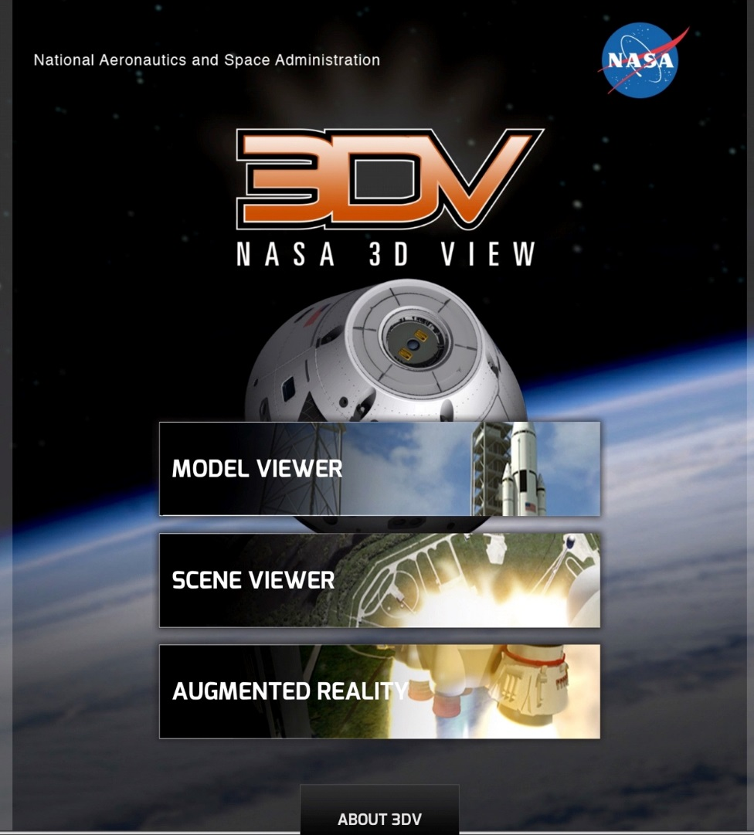
DLN™ Professional Development
Notes:
NASA DLN on Camera Presentation Guidelines-Michael Perri where I learned about how to work a tricaster and on camera presence.
I learned about different NASA apps, One of my favorites is NASA 3D View
This app allows 3D Models of things like Model viewer where you can see a Space launch system, the crawler, launch tower, Orion spacecraft
The GLOBE Program

Slide 7
African American History Day at Virginia Air and Space Center
General public event
200 – 300 people present
Notes:
This event was in January on Saturday. Here children and students from ECSU came to Virginia Air and Space Center. At our booth where I got the opportunity to work with Janet, we talked about Astronauts and how they lived. We had a sleep suit to show how they sleep, along with space food to show how there portions are smaller than the potions we eat here on Earth. To show how pressure difference can affect the human body

Slide 8
Engineering Career Days
Two day event at the Newport News Ship Building
300 students each day
Student round table with Junior and Senior High School students
Engineering Design Challenge “Build a capsule to protect a spacecraft”
Notes:
February 25-26, 2016
Career table rotation
Student tables
NASA “Drag Race to Mars” Engineering Design Challenge
This was a two day event, in February. I had the opportunity to talk to junior and senior high school students about careers in STEM, college, how I became interested in STEM, what I do here as NASA Langley as an intern, and different careers that they could do in STEM, then I help do NASA “Drag Race to Mars” Engineering Design Challenge.
.

Slide 9
NASA Day at ECSU
300 students
Middle school to college level students
ECSU presentations included a virtual connection with Caryn through the LaRC DLN™
Notes:
NASA Day at ECSU is an event part of Research week. During this event I helped Rosemary and Bonnie with the exhibit 7 Minutes of Terror: Landing on Mars. There were 300 students at this event from middle to college level. I got to help with the testing and see different designs done by the students.
ECSU presentations included a virtual connection with Caryn through the LaRC DLN

Slide 10
Motivational Speakers
Notes:
I also got to listen to different speakers. Like Dr. Alleyne. She currently serves as the Associate Program Scientist for the International Space Station (ISS) she is responsible for developing the strategies that benefits the scientific research that is done on the ISS. This speaker stood out to me the most because her goal is to promote young women in STEM. Her speech also resonated with me as now I am entering courses in my major that are challenging and she mentioned that STEM majors are not easy but the end result is worth it.

Slide 11
Facility Tours at LaRC
Hanger
14x22 Foot Subsonic Tunnel
Sonic Boom Simulation
Supersonic/Hypersonic Wind Tunnel
Live Broadcast from the ARRM Facility to NNPS
Notes:
Asteroid Recapture Redirect Mission
Newport News Publics Schools

Slide 12
Tour in the Hanger
Building 1244
85,200 square feet of open hangar space
Notes:
Here I was able to have a tour of the hanger. I saw different planes and learned about the different technologies that where being put in the hanger.
large door dimensions allow for entry of big aircraft such as Boeing 757s and other commercial or military transport-class aircraft.

Slide 13
Tour of the 14x22 Foot Subsonic Tunnel
Building 1212c
Lead Frank Quinto
Notes:
Frank Quinto lead a tour of the 14x22. The purpose of this tour was to do a test of connection in the tunnel for future connections that could be giving in the tunnel it self.
The 14' by 22' tunnel was constructed in 1970 to provide an improved understanding of the aerodynamics of vertical/short takeoff and landing (V/STOL) aircraft.

Slide 14
Sonic Boom Simulation
Building 1208
Lead Jonathan Rathsam
Subjective reaction to sonic boom noise in a controlled environment
Notes:
The Sonic Boom Simulator (SBS) is a facility for studying human response to sonic booms experienced in an outdoor environment.

Slide 15
Supersonic/Hypersonic Wind Tunnels
Building 1251A
Tour lead Ms. Karen Berger
Notes:
A hypersonic wind tunnel is designed to generate a hypersonic flow field in the working section, thus simulating the typical flow features of this flow regime - including compression shocks and pronounced boundary layer effects, entropy layer and viscous interaction zones and most importantly high total temperatures of the flow.

Slide 16
Live Broadcast from the ARRM Facility to NNPS
Building 1293A
Lead Scott Belbin
Notes:
Asteroid Recapture Redirect Mission
Newport News Publics Schools
How he used air to move objects around the floor

Slide 17
What I learned?
Notes:
What I learned during my internship was how to sharpen my presentation skills,
keeping myself on a steady schedule and to be able to explain my project clearly.
My internship experience influenced my view on what my career could be like as an Elementary School Teacher. It makes me want to work harder in school and graduate and begin grad school. This has shaped me and matured me by facing my fears of presenting.
Different presentations methods. This internship has open the door to the world of opportunity and that anything is possible. It is an experience that I will take with me for the rest of my life.

Slide 18
Acknowledgements
NASA LaRC
NIFs Program
Dr. Caryn Smith-Long
Dr. Gamaliel “Dan” Cherry
Office of Education

Slide 19
Questions?
Notes:
I will be working on documents with the Office of education
Preparing for the Praxis

